Slide 1
Data Science with Python CS 498 (Special Topics in Computer Science) Machine Learning-Example NB
Dr. Malak Abdullah
Computer Science Department
Jordan University of Science and Technology

Slide 2
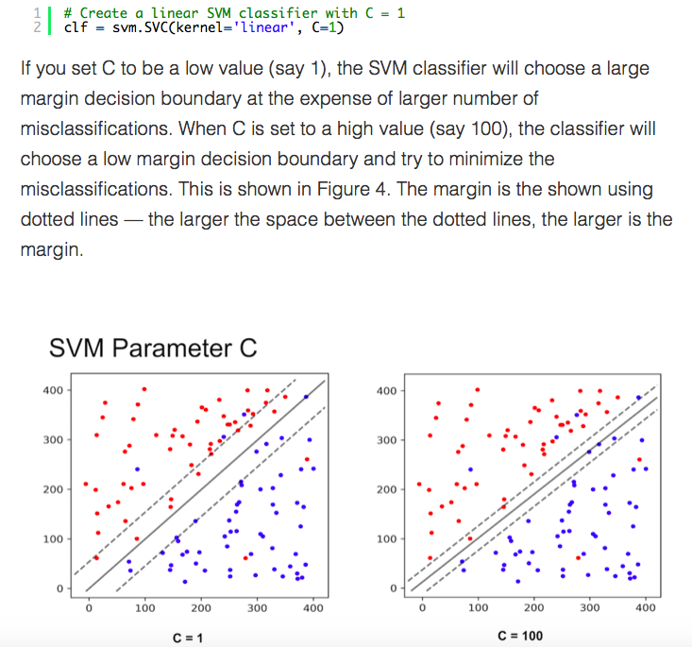
SVM & Noisy data
You may be tempted to ask which value of C is better. The answer depends on how much noise you think there is in your data. If you think the data is very noisy, you want C to be small. On the other hand, if you think the data is less noisy, you should choose C to be large.

Slide 3
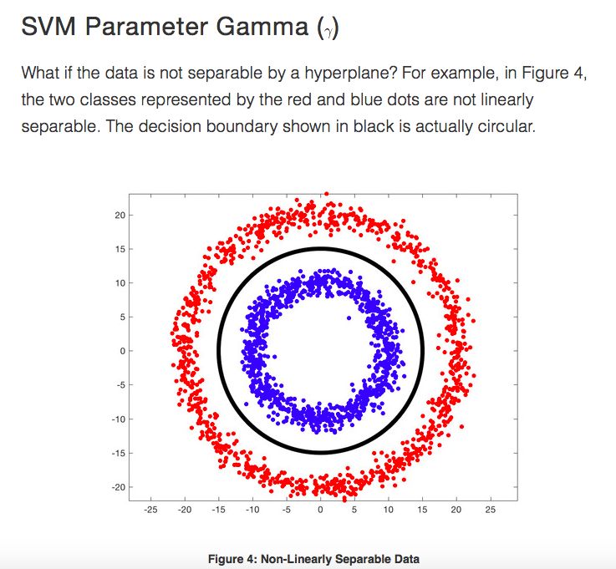
In such a case, we use the Kernel Trick where we add a new dimension to existing data and if we are lucky, in the new space, the data is linearly separable.
Lets add a third dimension (z) to the data where,
The above expression is called a Gaussian Radial Basis Function or a Radial Basis Function with a Gaussian kernel.

Slide 4
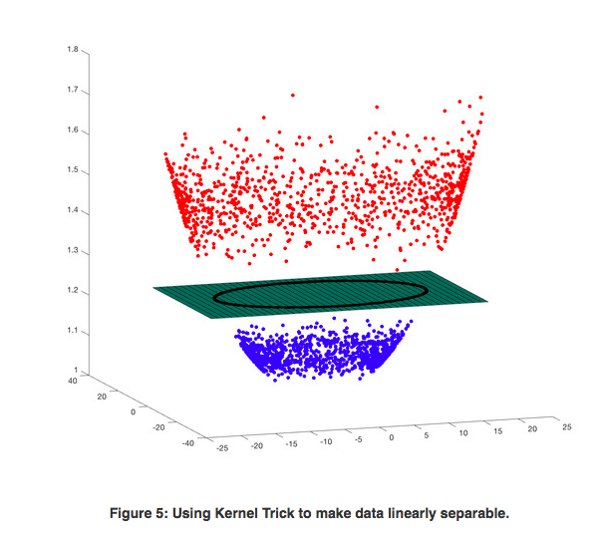

Slide 5
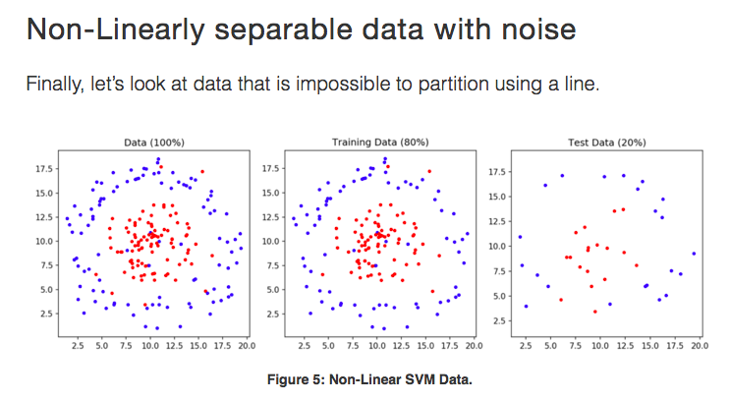

Slide 6
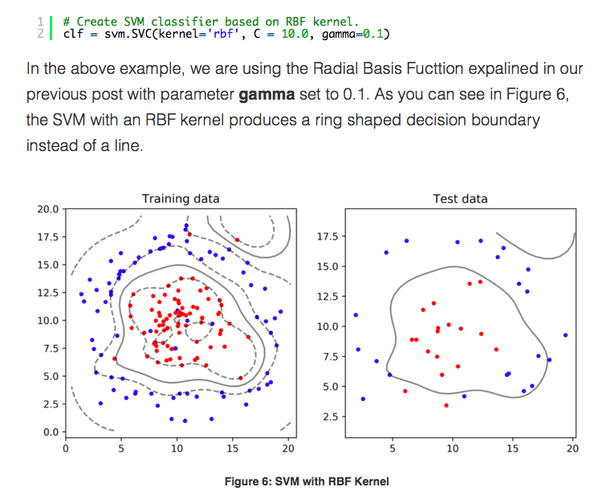

Slide 7
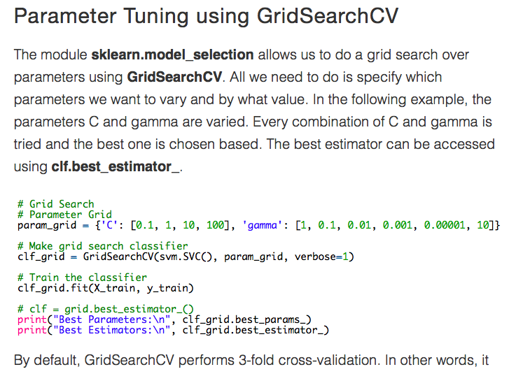

Slide 8
EXAMPLE

Slide 9
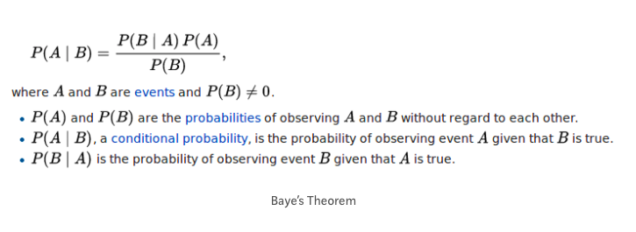
SPAM or Ham?
We all face the problem of spams in our inboxes.
Let’s build a spam classifier program in python which can tell whether a given message is spam or not!
We will use Naïve Bayes (NB)

Slide 10
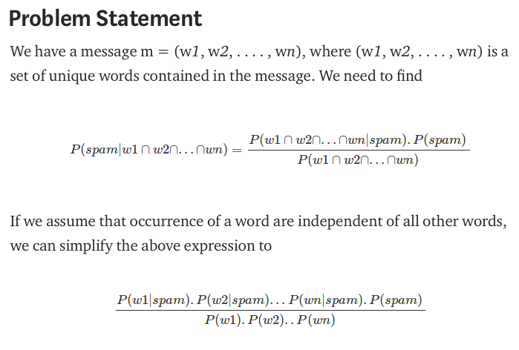

Slide 11
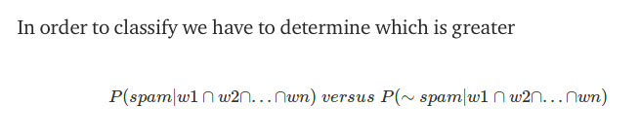
IS it SPAM or HAM!!!!

Slide 12
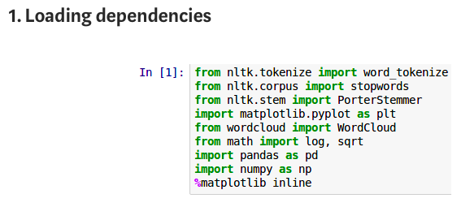

Slide 13
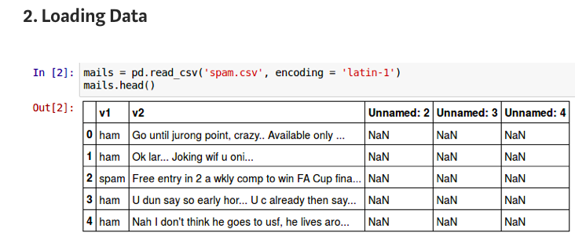
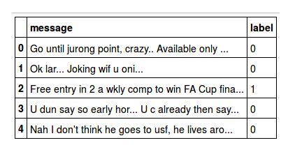
We only need V1 and V2

Slide 14
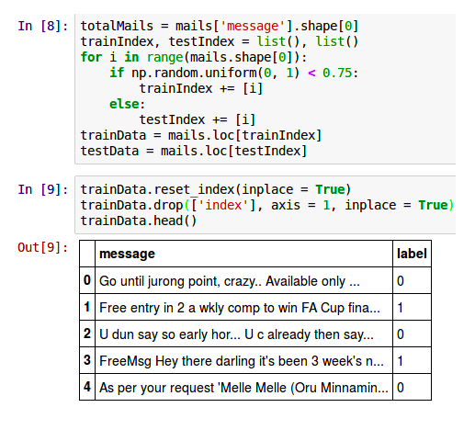
2- Split-train-test
This is another way to split the data randomly!!
Pay attention: how to replace the indexing !!!

Slide 15
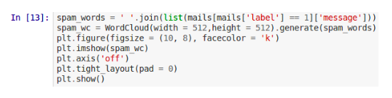

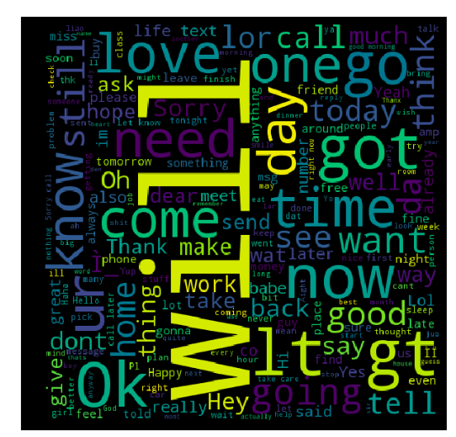
Exploring
spam
ham

Slide 16
Preprocessing:
Make all the character lowercase. This is because ‘free’ and ‘FREE’ mean the same and we do not want to treat them as two different words
Tokenize each message in the dataset
The words like ‘go’, ‘goes’, ‘going’ indicate the same activity. We can replace all these words by a single word ‘go’. This is called stemming
Remove the stop words
Optional: You can also use n-grams to improve the accuracy.
when two words are together the meaning totally changes. For example, ‘good’ and ‘not good’ are opposite in meaning. Suppose a text contains ‘not good’, it is better to consider ‘not good’ as one token rather than ‘not’ and ‘good’. Therefore, sometimes accuracy is improved when we split the text into tokens of two (or more) words than only word.

Slide 17
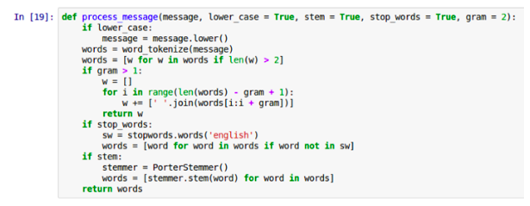
Preprocessing

Slide 18
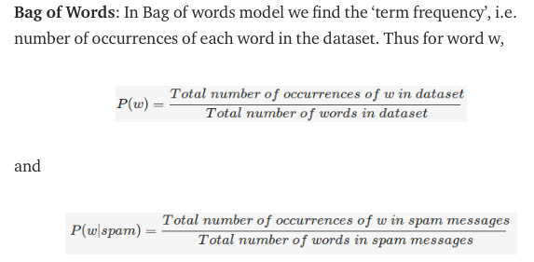
Extracting Features (1)

Slide 19
BOW. Bag of Words
from sklearn.feature_extraction.text import CountVectorizer
vectorizer = CountVectorizer (max_features=1500, min_df=5, max_df=0.7,
stop_words=stopwords.words('english’))
X = vectorizer.fit_transform(text).toarray()
Max_features: documents can contain tens of thousands of unique words, knowing that the words that have a very low frequency of occurrence are unusually not a good parameter for classifying documents. In the above example, we want to use 1500 most occurring words as features for training our classifier.
min_df=5, max_df=0.7: The minimum number and the maximum percentage of documents that should contain this feature
stop_words=stopwords.words('english’): To remove the stop words

Slide 20
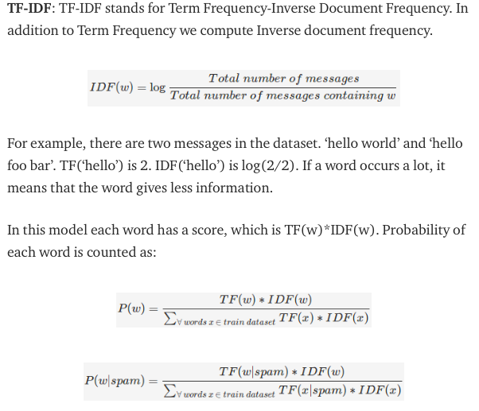
(2)

Slide 21
from sklearn.feature_extraction.text import TfidfVectorizer
tfidfconverter = TfidfVectorizer (max_features=1500, min_df=5, max_df=0.7, stop_words=stopwords.words('english’))
X = tfidfconverter.fit_transform(documents).toarray()

Slide 22
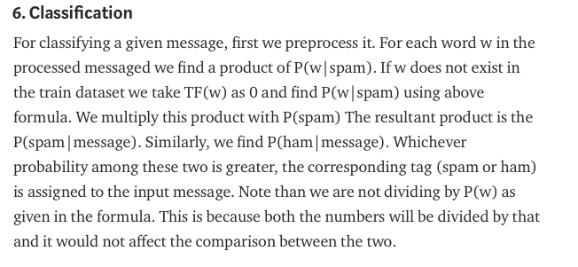
The code: https://github.com/tejank10/Spam-or-Ham/blob/master/spam_ham.ipynb

Slide 23
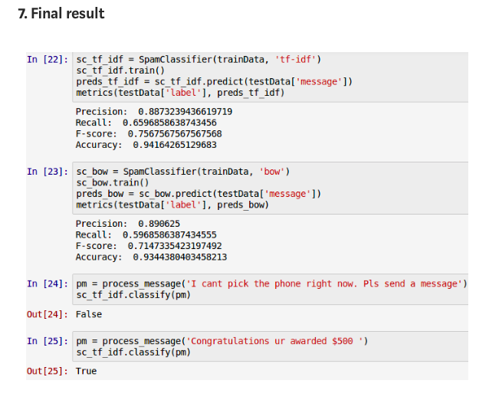
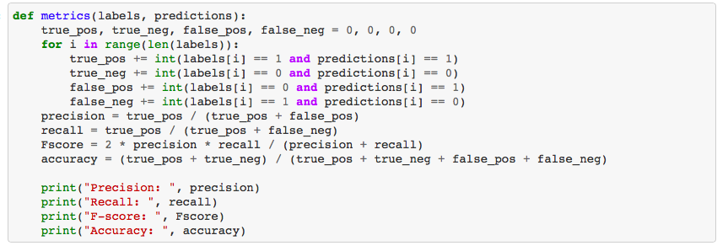

Slide 24
Recourses & References
https://towardsdatascience.com/spam-classifier-in-python-from-scratch-27a98ddd8e73
https://www.learnopencv.com/svm-using-scikit-learn-in-python/

